Slide 1

Overcoming Extended School Year

Slide 2


Slide 3


Slide 4


Slide 5
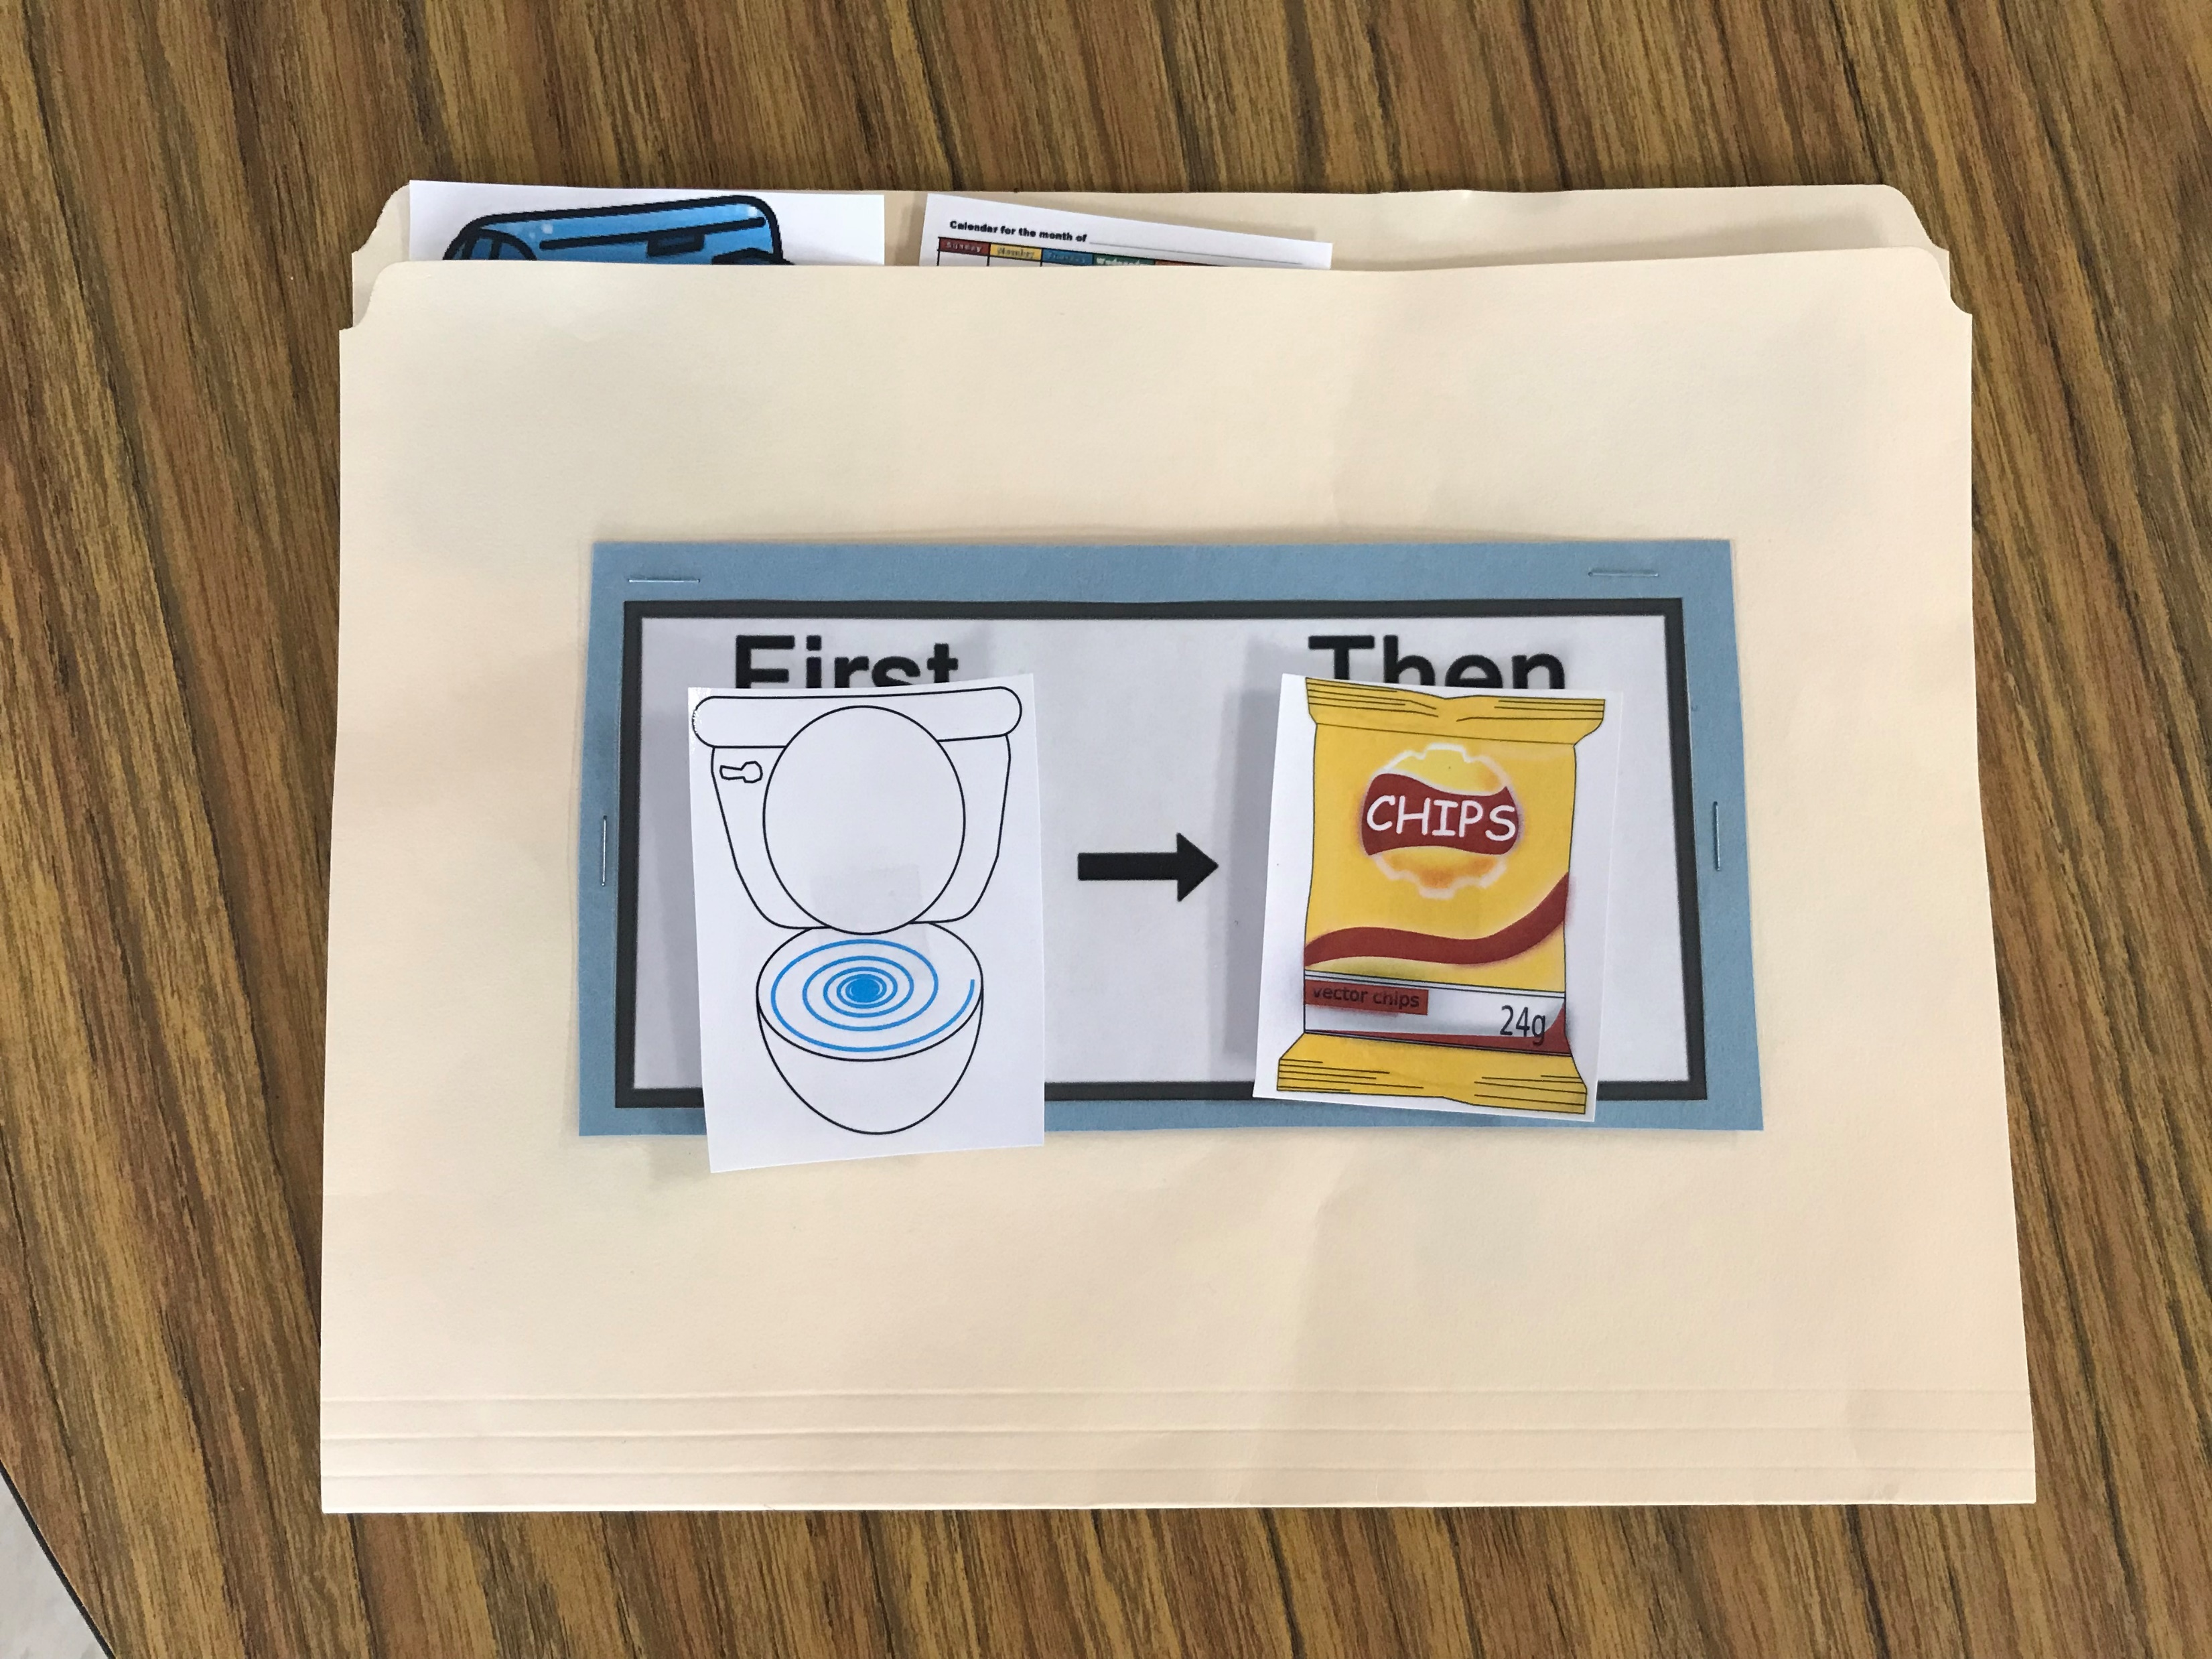

Slide 6
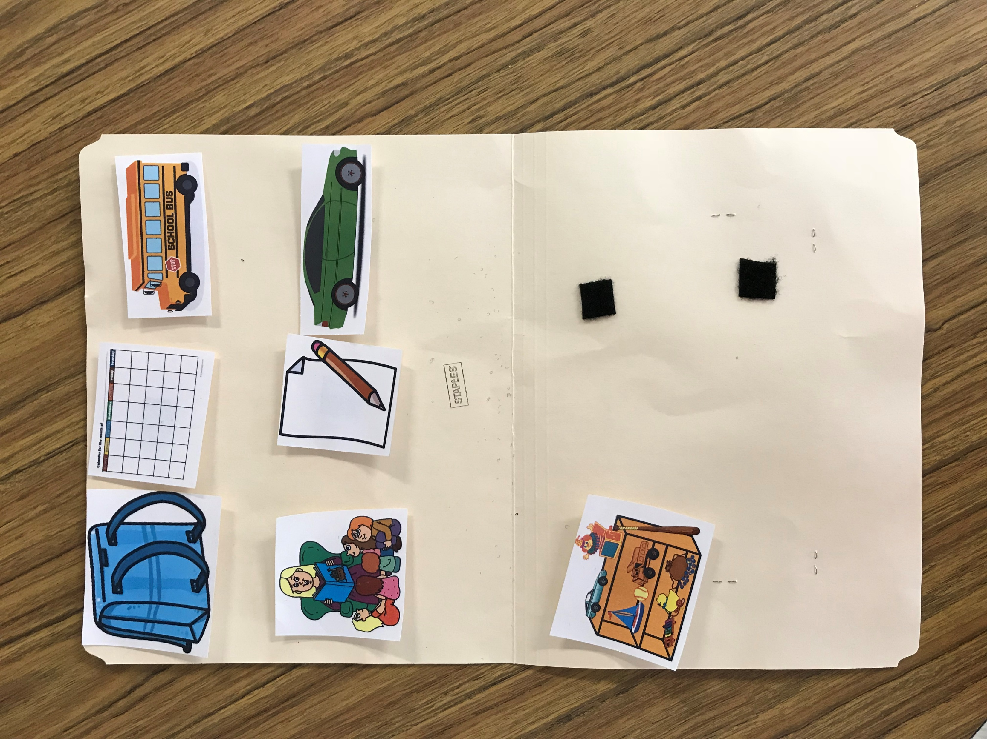

Slide 7


Slide 8
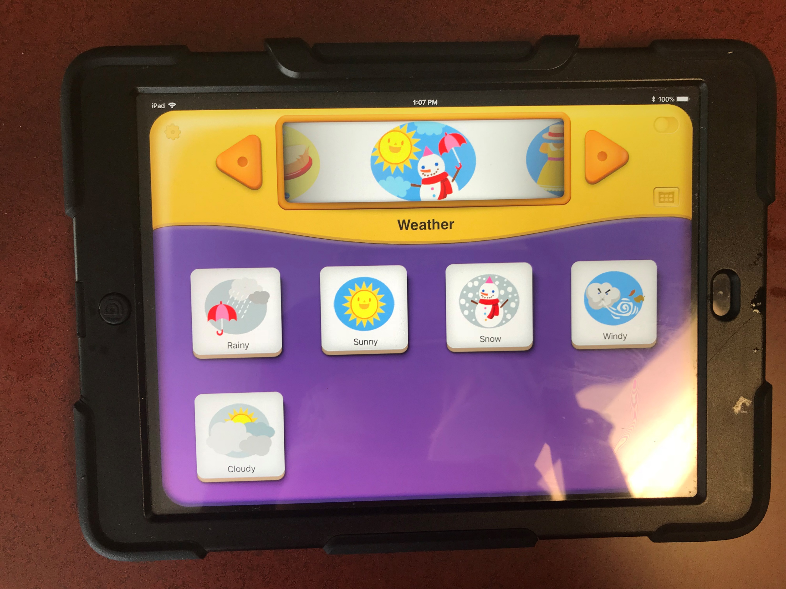

Slide 9
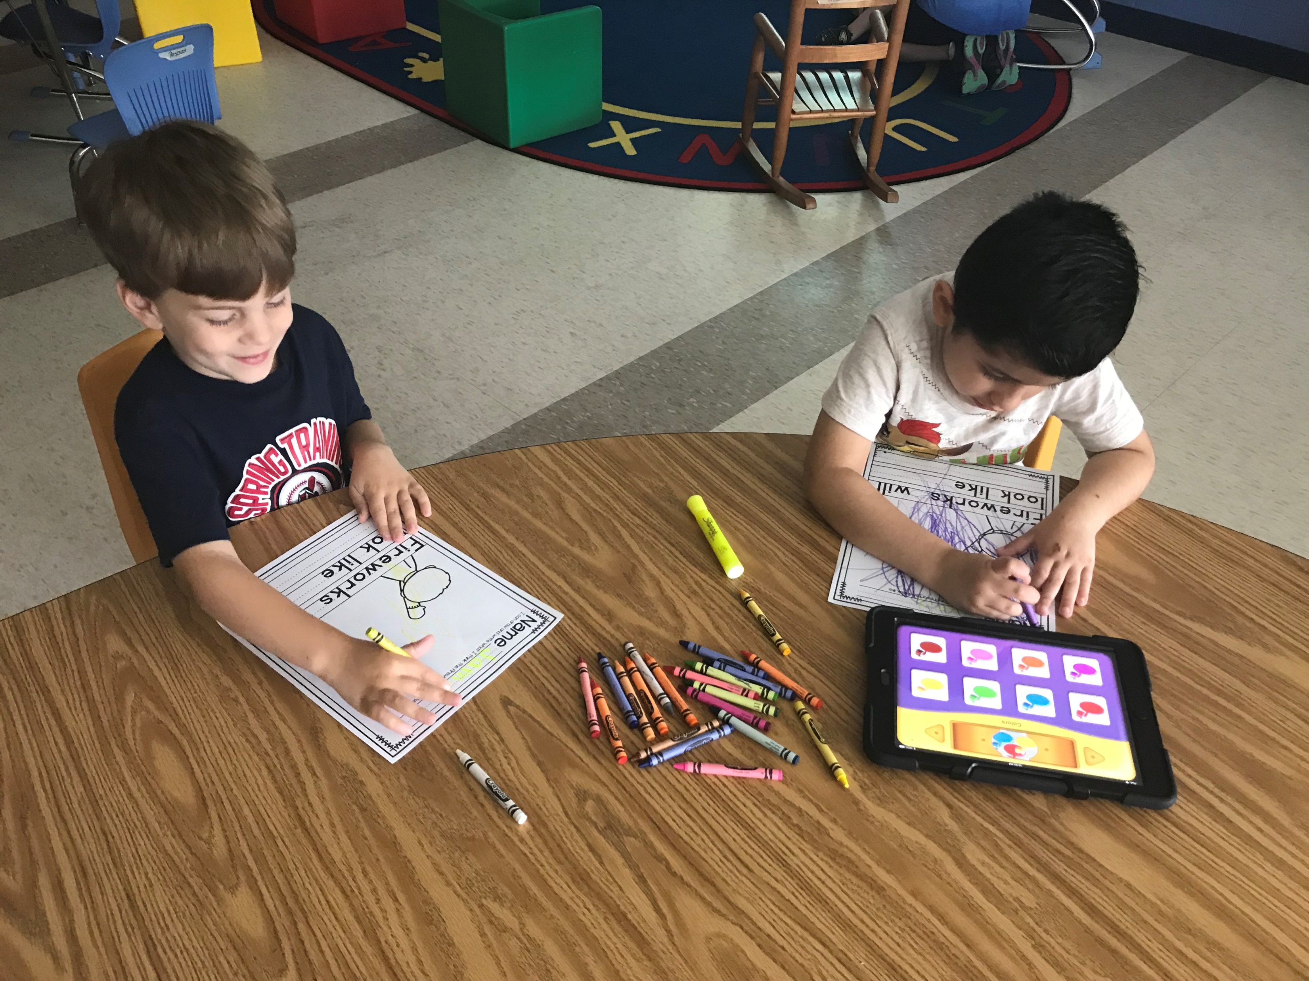

Slide 10
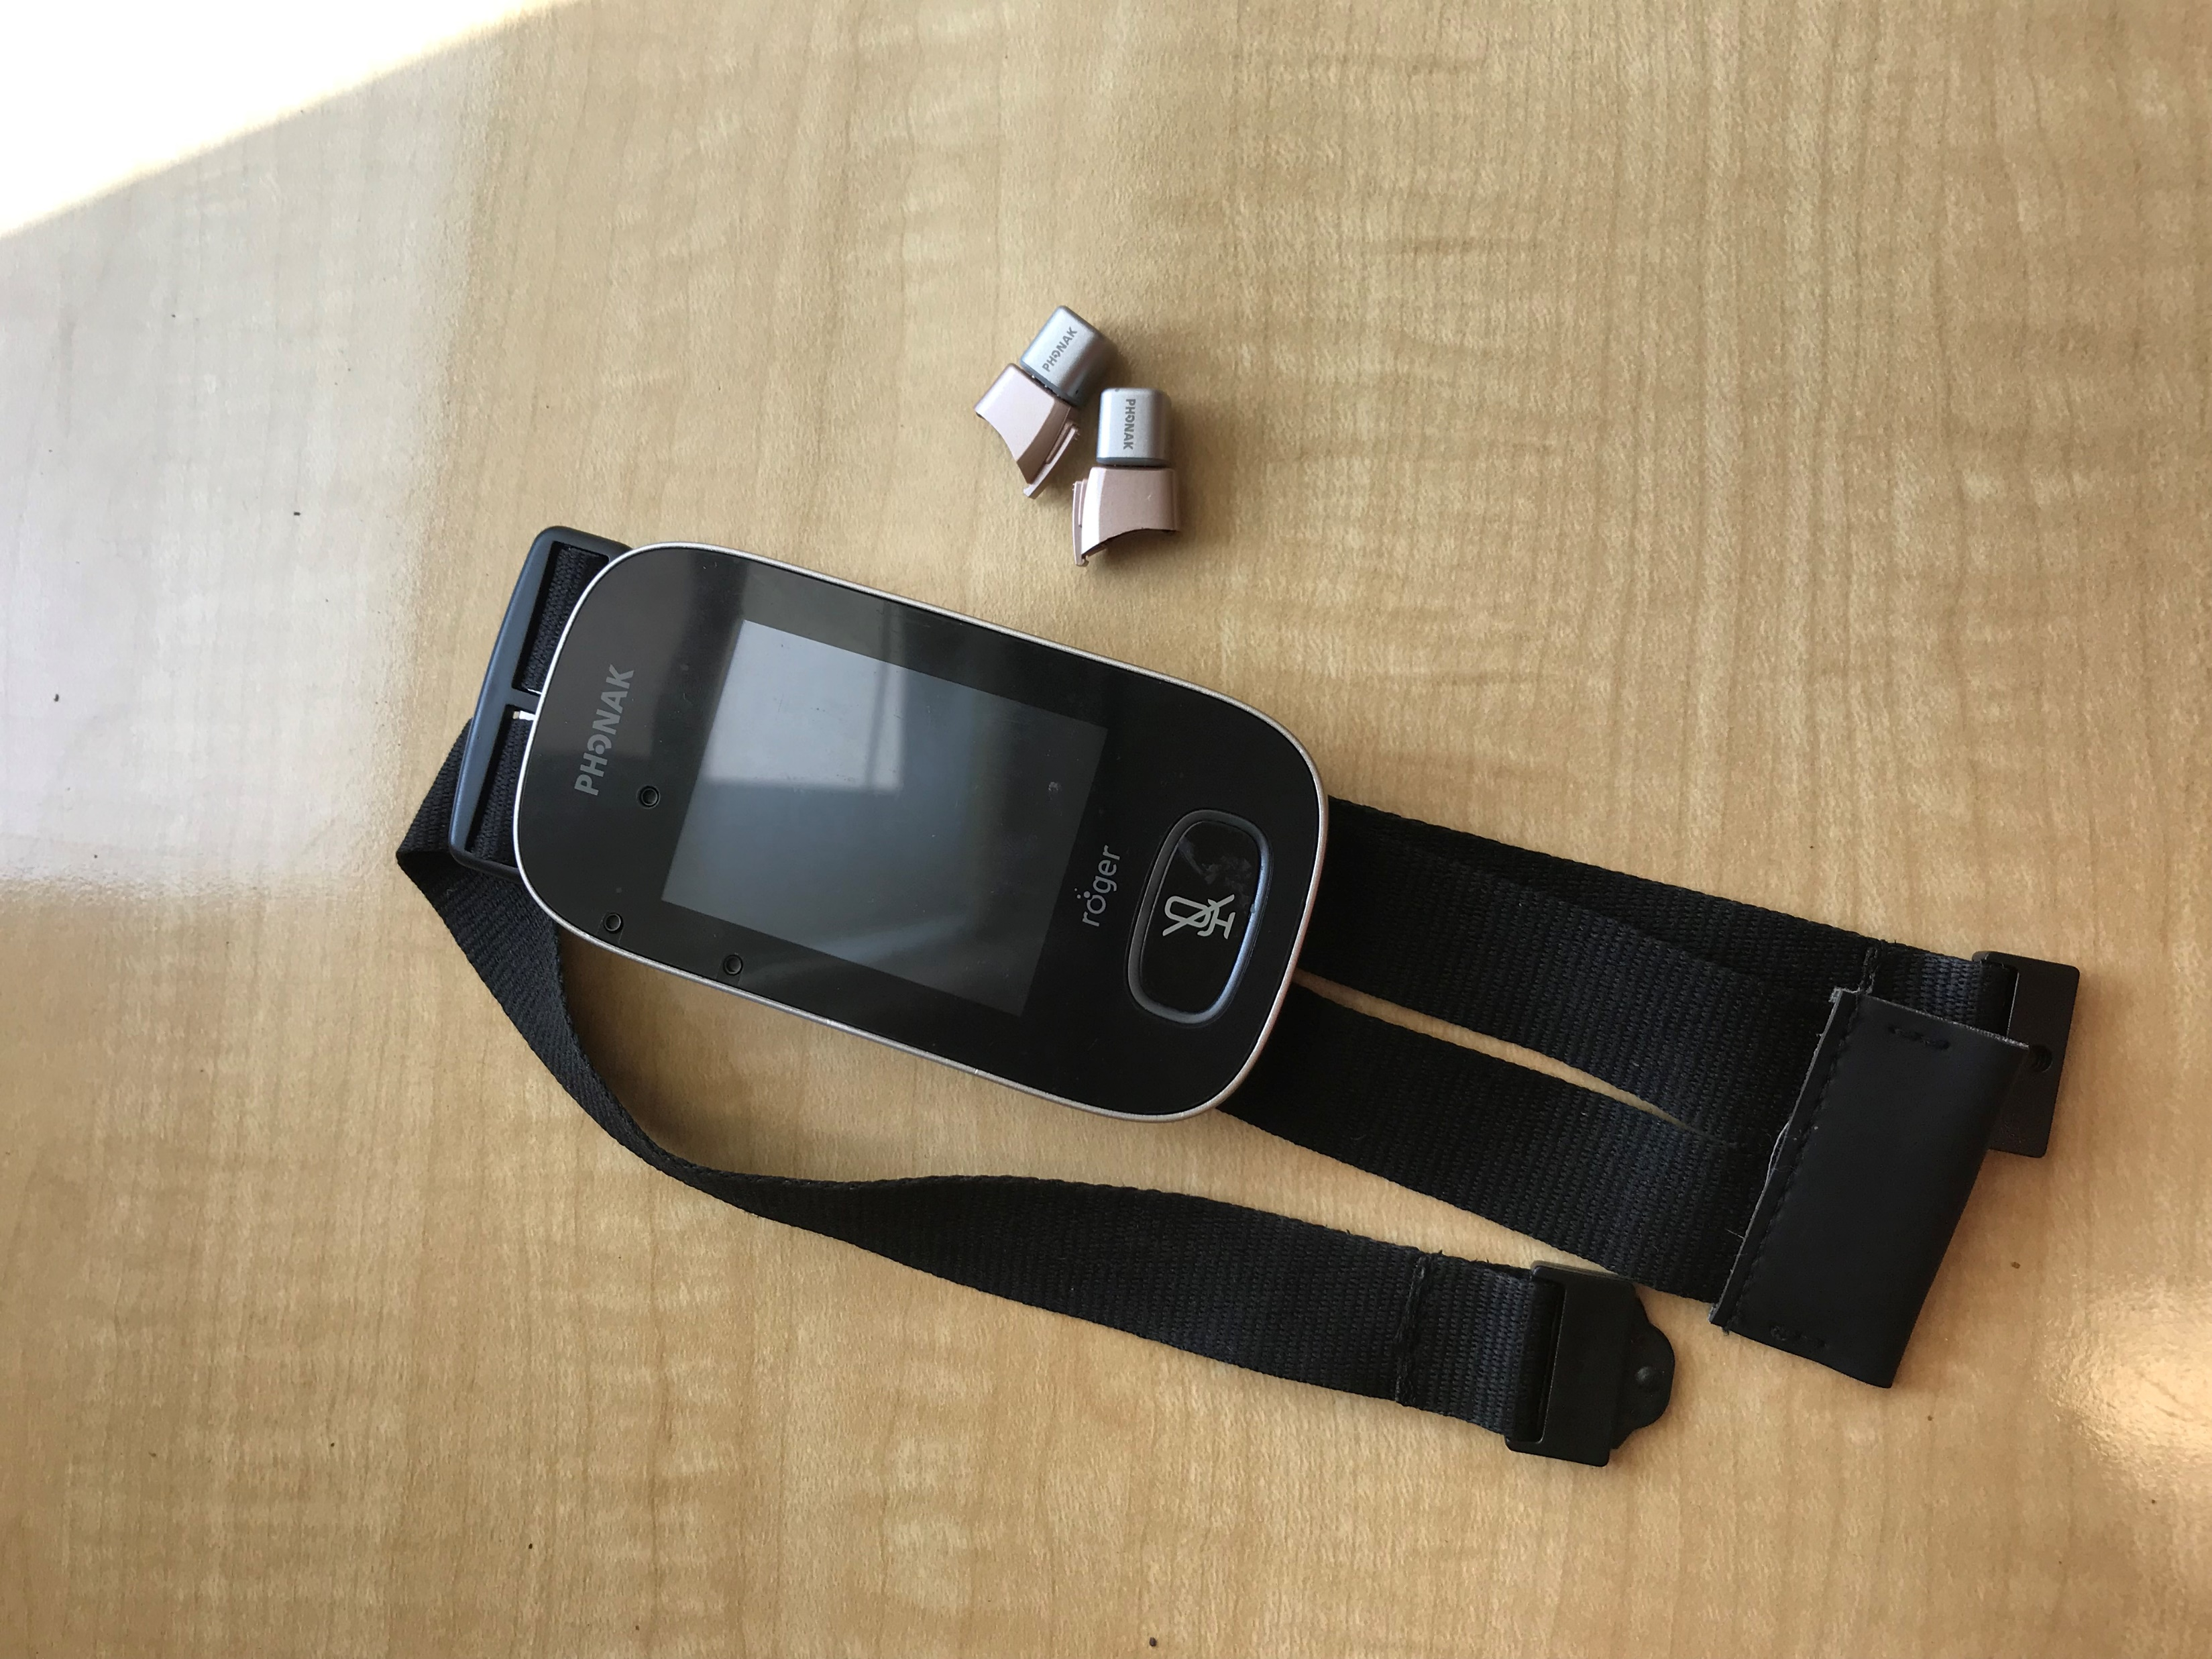

Slide 11
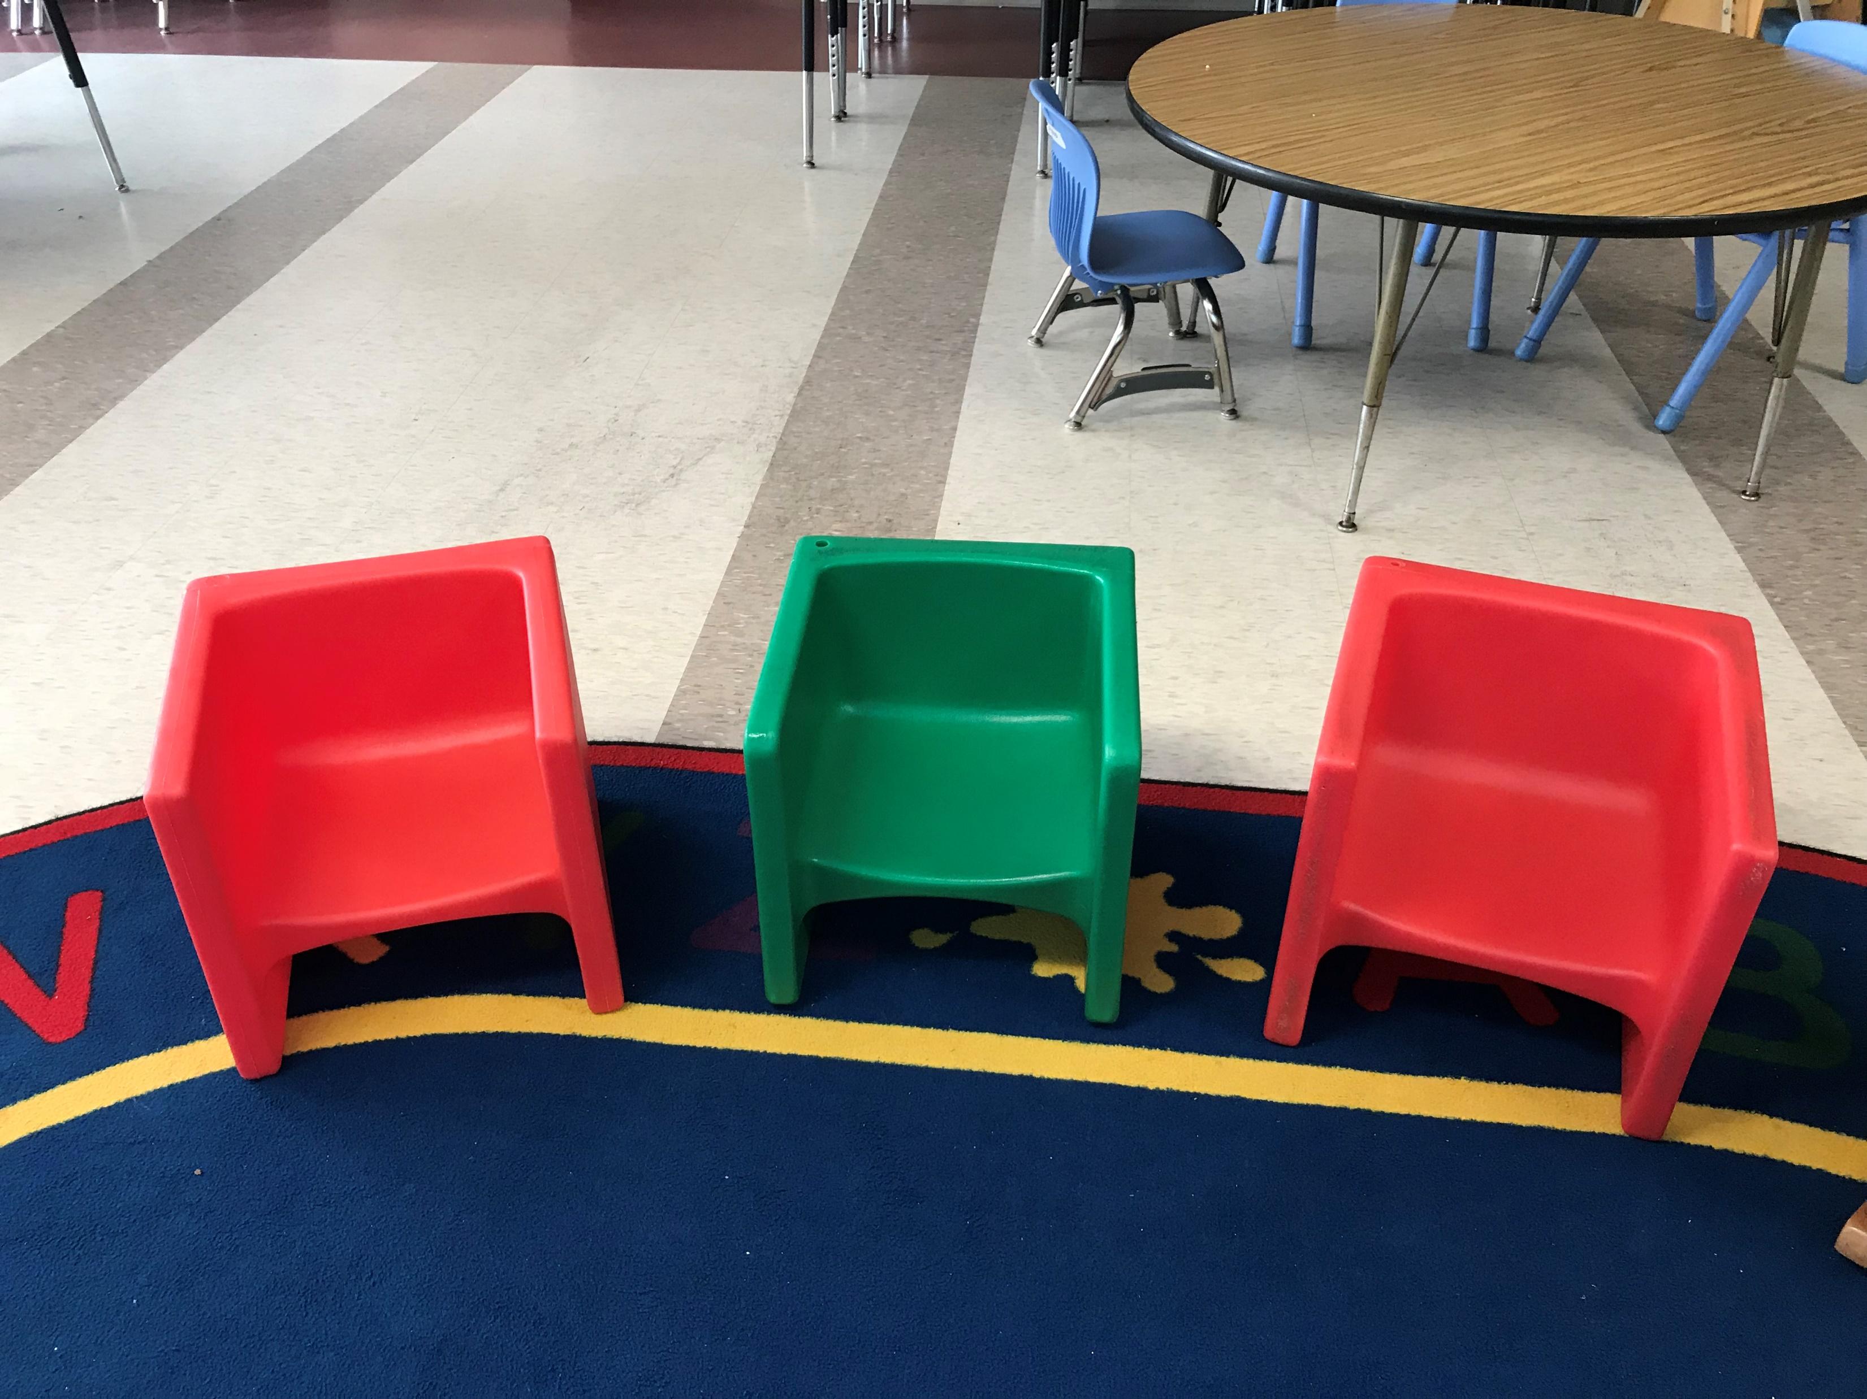

Slide 12
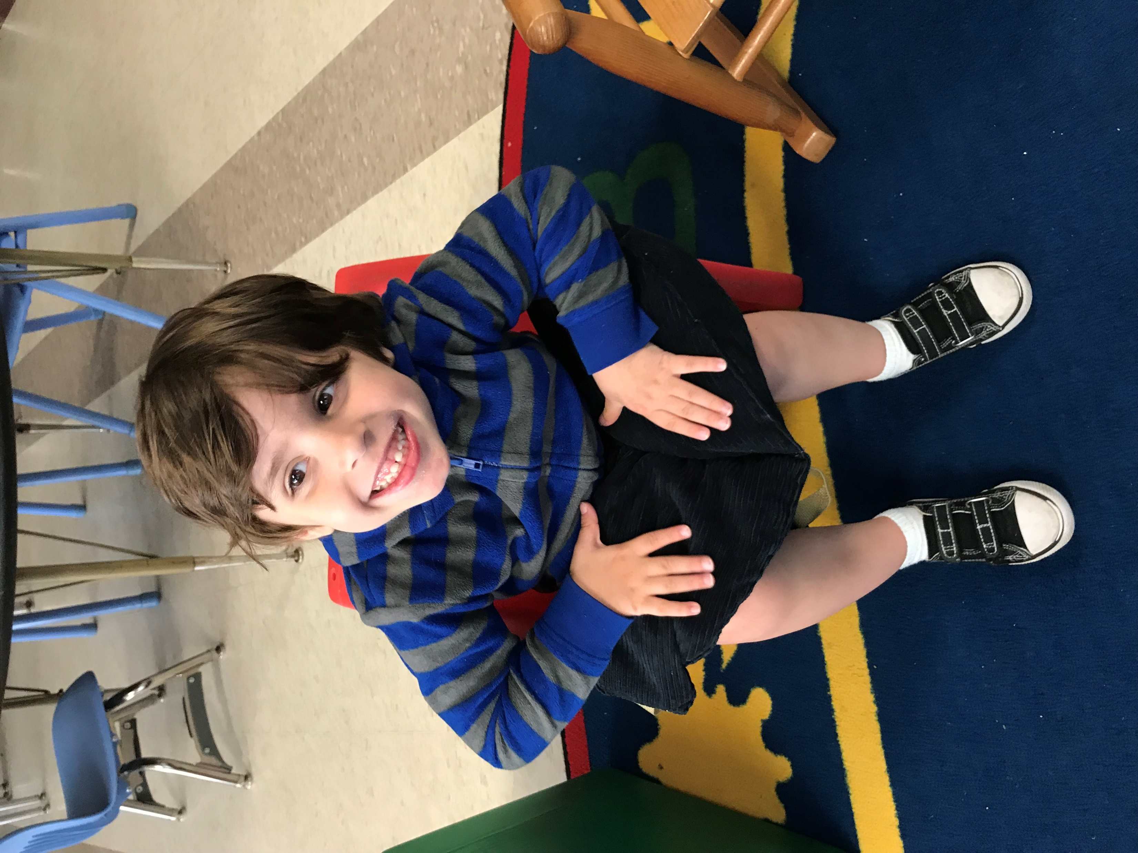

Slide 13


Slide 14


Slide 15
Thank you for watching!
EDITING BY
Raechel Baucco
WRITTEN BY
Raechel Baucco
AUDIO BY
Raechel Baucco
PICTURES BY
Raechel Baucco’s Personal Camera and Google Images

